Slide 1
How to get the Matrix working for you
How the Parking Industry can leverage ChatGPT and other A.I.

Slide 2
Learning Objectives
Ways that AI tools can enhance your customer experience
How AI can streamline operations
How AI enhances the customer expereince

Slide 3
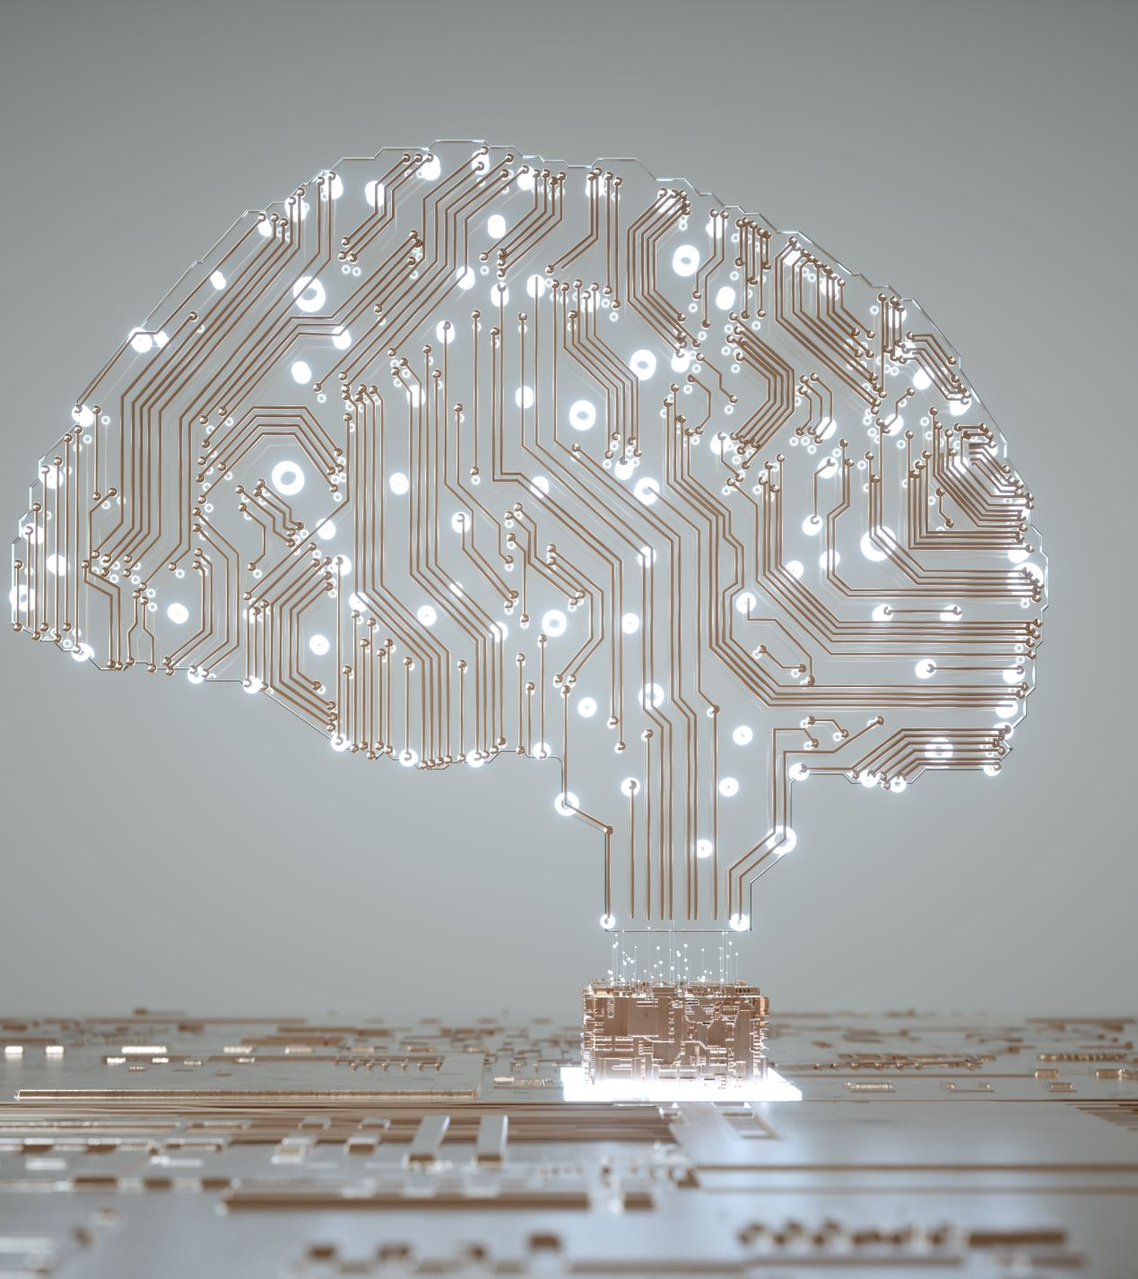
Artificial Intelligence (AI)
refers to the simulation of human intelligence processes by machines, particularly computer systems. These processes include learning, reasoning, problem-solving, perception, and language understanding. AI aims to create systems that can mimic cognitive functions and perform tasks that typically require human intelligence.

Slide 4
Examples of AI
Natural Language Processing (NLP)
Machine Learning (ML)
Computer Vision
Robotics
Expert Systems
Autonomous Vehicles
Notes:
Natural Language Processing (NLP): Understanding and generating human language, enabling chatbots, language translation, and sentiment analysis.
Machine Learning (ML): Algorithms that allow systems to learn from data, make predictions, and improve performance over time. Applications include recommendation systems, predictive analytics, and fraud detection.
Computer Vision: Using algorithms to interpret and analyze visual information from images or videos. Applications include object recognition, facial recognition, and image classification.
Robotics: Designing intelligent machines capable of performing tasks autonomously or semi-autonomously, ranging from industrial automation to service robots.
Expert Systems: AI systems that emulate the decision-making abilities of human experts in specific domains, aiding in diagnosis, planning, and problem-solving.
Autonomous Vehicles: Developing self-driving cars that utilize AI technologies such as computer vision, machine learning, and sensor fusion to navigate and interact with the environment safely.

Slide 5
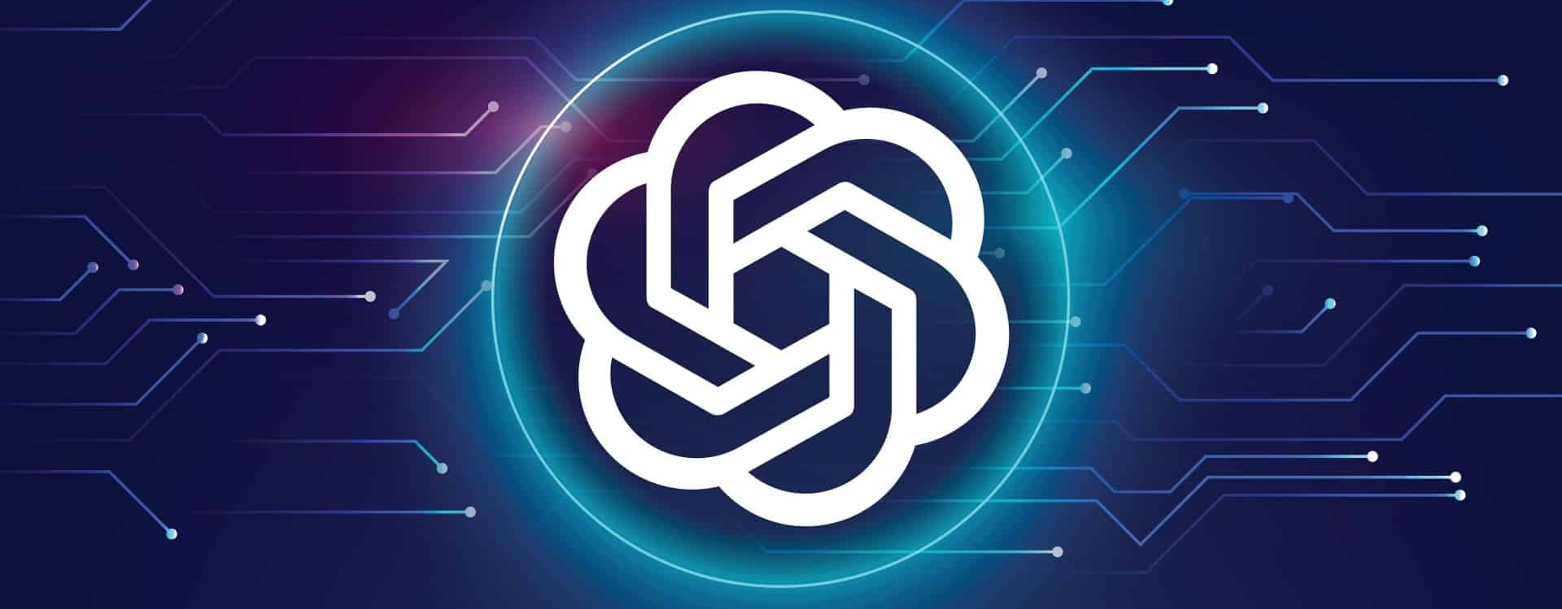
ChatGPT
Start with the basics first
Notes:
Creating a customer support system for your business with ChatGTP is a great way to ensure that your customers are getting the help they need. The process starts by customizing the system to fit your unique business needs. This includes selecting the right chatbot, setting up the right ticketing system and automated responses, and setting up the right customer support team. With ChatGTP, you can also track customer interactions and analyze customer feedback to improve customer service. Additionally, ChatGTP allows you to quickly respond to customer inquiries, helping to reduce customer wait times. Finally, ChatGTP offers a range of integrations, allowing you to integrate with existing customer service systems and customer databases. The benefits of ChatGTP are immense, and the process of creating a customer support system for your business with ChatGTP is easy and straightforward.

Slide 7
Write Like You
ChatGPT Understands
Explain and Provide Sample

Slide 8
Does Word Count Matter?
Specify the word count if response it to long or too short

Slide 9
Specify Format Required
Text
Chart
Table
Code

Slide 10
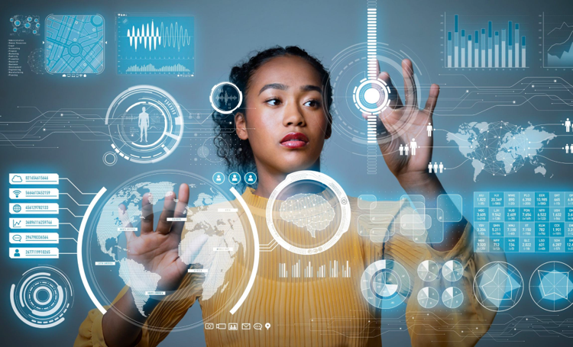
How ChatGPT can help with Customer Service

Slide 11
Respond to customer emails
General information
Inquires
Support assistance
Thank you notes
FAQ responses

Slide 12
Have ChatGPT be a critic

Slide 13
Cross Language Barriers General Spanish

Slide 14
Cross Language Barriers Spanish-Miami Dialect

Slide 15
Parking Rate Studies

Slide 16
Parking Rates-Chattanooga

Slide 17
Parking Rate Surrounding Cities

Slide 18
Building Systems, Processes & Documentations
SOP’s , Procedures, Job Descriptions, etc.

Slide 19
Sample SOP

Slide 20
Results Sales Videos Using Vidyard

Slide 21
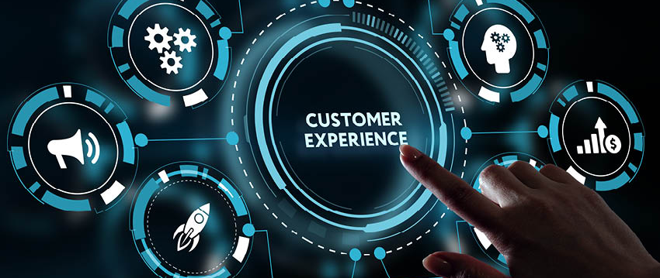
Benefits of ChatGPT in CX

Slide 22
5 Benefits
New Generation of Chatbots
Intelligence Augmented
Conversation Management on social media
Innovation
ChatGPT can also code
Notes:
Augmented—makes us faster– ask ChatGPT to do the work for you
Have CHATGPT respond to first response on reviews or postings
Innovation—Ask ChatGPT what can I do to be more innovative on ??????

Slide 23
Alternatives Tools
ChatSonic (can create digital artwork and templates)
Jasper AI (used for social media type writing)
BARD (provides 3 options on each request)
Bing AI (conversational power search engine)
CoPilot (code completion tool)
Notes:
https://openai.com/chatgpt/team

Slide 24
Advantages & Disadvantages
Advantages
Disadvantages
24/7 Availability
Efficiency
Scalability
Cost-Effective
Multilingual Support
Lack of Emotional Intelligence
Inaccuracy
Over-Reliance
Privacy Concerns
Initial Setup Complexity
Notes:
Advantages:
24/7 Availability: Chat GPT provides round-the-clock customer support, enhancing user experience and ensuring inquiries are addressed promptly.
Efficiency: It automates repetitive tasks, such as answering frequently asked questions, reducing workload and human error.
Scalability: Chat GPT can handle numerous queries simultaneously, making it ideal for businesses with fluctuating workloads.
Cost-Effective: It reduces the need for hiring and training additional staff, resulting in cost savings.
Multilingual Support: Chat GPT can communicate in multiple languages, broadening its reach to a global audience.
Disadvantages:
Lack of Emotional Intelligence: Chat GPT lacks emotional understanding, making it less effective in handling emotionally charged or complex situations.
Inaccuracy: It may provide incorrect information, especially when dealing with ambiguous or unfamiliar queries.
Over-Reliance: Excessive reliance on Chat GPT can lead to reduced human interaction, impacting relationships and customer satisfaction.
Privacy Concerns: Handling sensitive data raises privacy and security concerns, requiring robust data protection measures.
Initial Setup Complexity: Implementing Chat GPT involves substantial setup and training, which can be time-consuming and costly.

Slide 25
BEWARE
Avoid Sharing
Personal Information (PII)
Sensitive & Confidential Information
Passwords
Malware and Cyber Attacks can still occur verify their security measures

Slide 26
Katherine Beaty
EVP of Customer Experience
TEZ Technology
Katherine@teztechnology.com

